Slide 1
UNIT-3

Slide 2
Objectives
To understand the importance of knowledge representation in intelligent agents .
To understand the use of formal logic as a knowledge representation language.
The student should be familiar with the following concepts of logic, 1) syntax 2) semantics 3) validity 4) satisfiability 5) interpretation and models 6) entailment
To understand each of the above concepts in propositional logic .
To Students should learn different inference mechanisms in propositional logic.

Slide 3
Knowledge Representation and Reasoning
Intelligent agents should have capacity for:
Perceiving, that is, acquiring information from environment,
Knowledge Representation, that is, representing its understanding of the world,
Reasoning, that is, inferring the implications of what it knows and of the choices it has, and
Acting, that is, choosing what it want to do and carry it out.

Slide 4
The primary component of a knowledge-based agent is its knowledge-base.
A knowledge-base is a set of sentences.
Each sentence is expressed in a language called the knowledge representation language.
Sentences represent some assertions about the world.
There must mechanisms to derive new sentences from old ones.
This process is known as inferencing or reasoning.
Inference must obey the primary requirement that the new sentences should follow logically from the previous ones

Slide 5
Logic
Logic is the primary vehicle for representing and reasoning about knowledge.
Formal language-The advantage of using formal logic as a language of AI is that it is precise and definite. This allows programs to be written which are declarative - they describe what is true and not how to solve problems.
Limitations of formal language: large portion of the reasoning carried out by humans depends on handling knowledge that is uncertain.
A logic consists of two parts-------language and a method of reasoning.

Slide 6
Syntax: Syntax specifies the symbols in the language and how they can be combined to form sentences.
facts about the world are represented as sentences in logic.
Semantics: It specifies what facts in the world a sentence refers to.
also specifies how you assign a truth value to a sentence based on its meaning in the world.
A fact is a claim about the world, and may be true or false.

Slide 7
Syntactic Inference Method: It refers to mechanical method for computing (deriving) new (true) sentences from existing sentences.
Facts are claims about the world that are True or False.
representation is an expression (sentence) in some language that can be encoded in a computer program and stands for the objects and relations in the world.

Slide 8
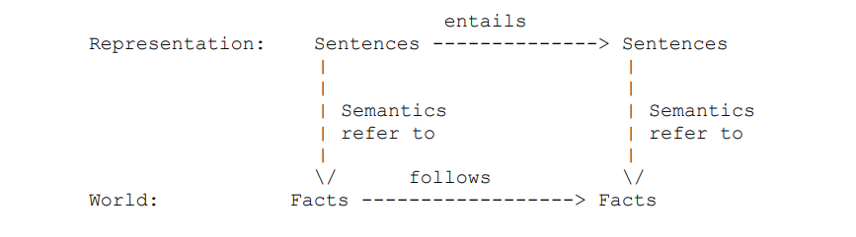

Slide 9
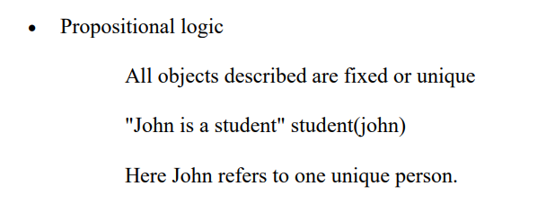
There are a number of logical systems with different syntax and semantics.

Slide 10
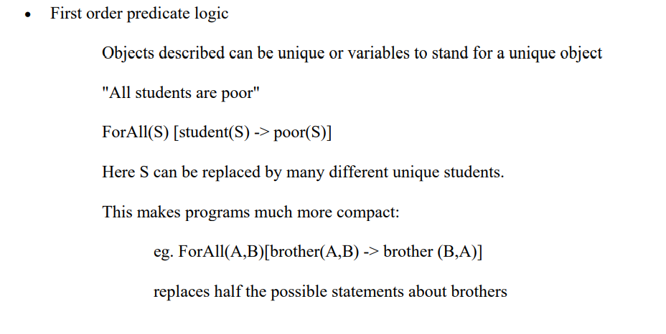

Slide 11
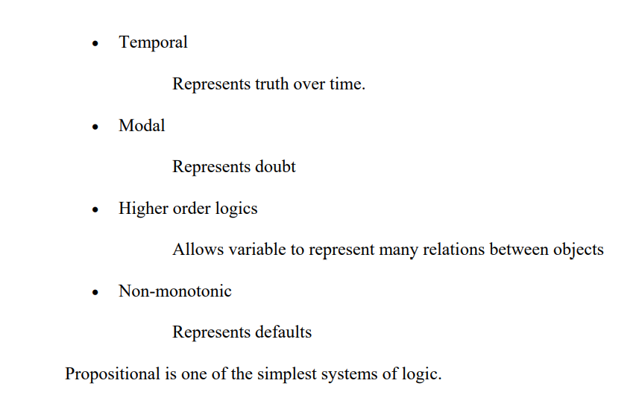

Slide 12
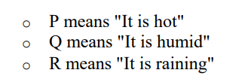
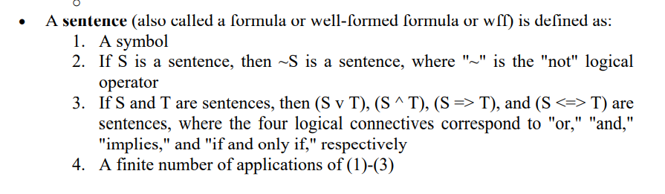
Propositional Logic
In propositional logic (PL) an user defines a set of propositional symbols, like P and Q.
User defines the semantics of each of these symbols.

Slide 13
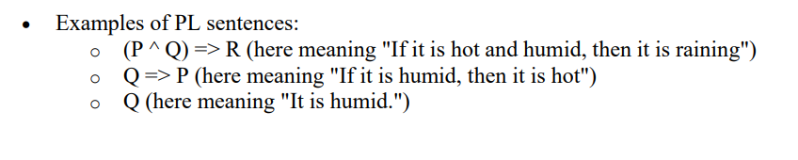

Slide 14
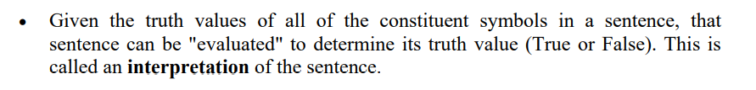

Slide 15
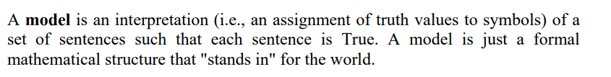

Slide 16
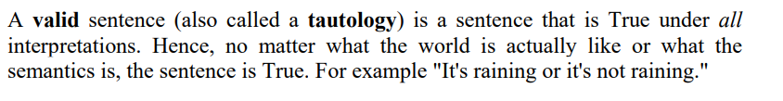

Slide 17
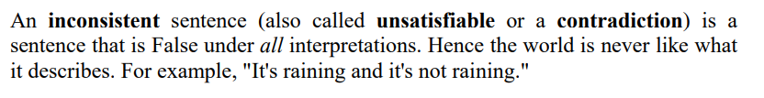

Slide 18
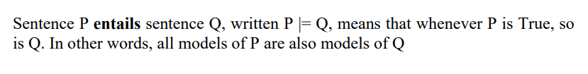

Slide 19
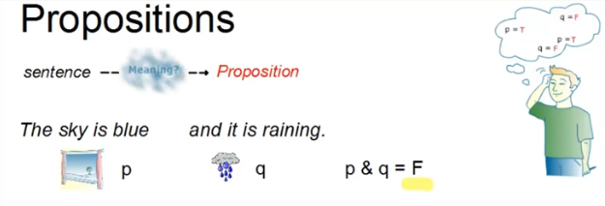

Slide 20
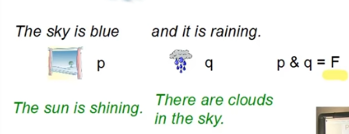
Inference

Slide 21
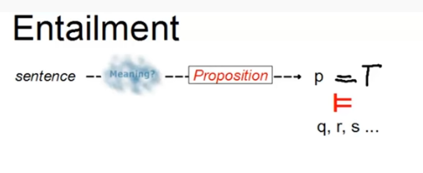
Logical inference are called Entailment

Slide 22
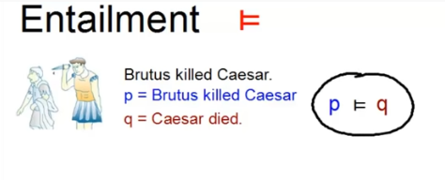

Slide 23
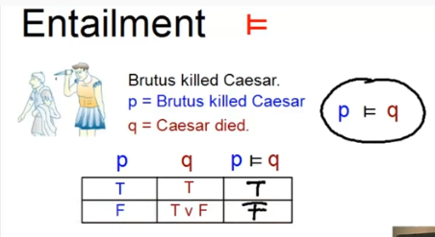

Slide 24
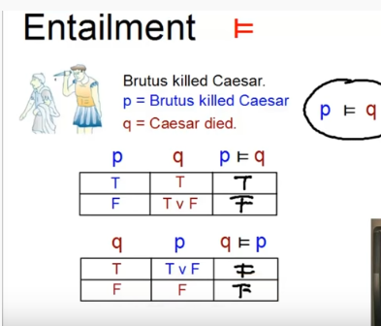

Slide 25
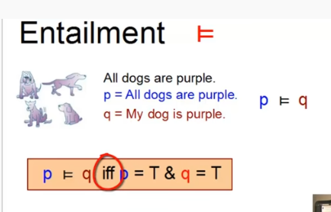

Slide 26
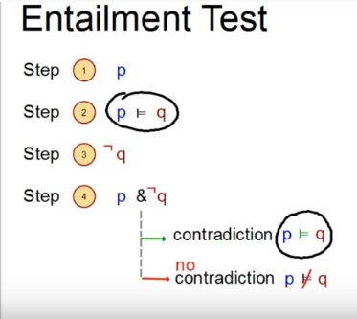

Slide 27
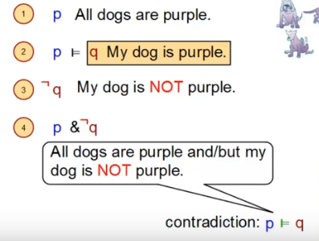

Slide 28
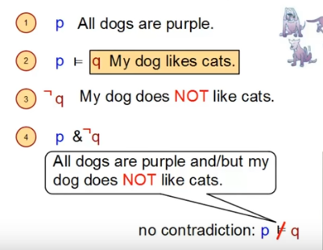

Slide 29
Reference
1) “Artificial Intelligence”,NPTEL,CSE,IIT,Khargpur
2)www.linguistics-online.com

